Slide 1
Essay writing tips & tricks LAWS8077 – Cyber Law
Dr Damian Clifford damian.clifford@anu.edu.au

Slide 2
Assessments
AT3 Research Essay - 50% The research essay will require students to conduct independent research that investigates a theme, issue or policy related to cyber law. Original research will be required. Essays must include a bibliography, which is excluded from the word count. Word Limit: 3,600 words Due Date: 5 pm, Friday 27 May 2022. Late submissions (without an extension) are permitted, although late penalties will apply.

Slide 3
Research essay questions
Critically examine the existing information sharing obligations and assess the regulatory challenges associated with effective public-private information sharing in the protection of critical infrastructures.
Critically examine the existing regulatory framework dealing with ransomware attacks with particular attention on the regulatory challenges posed by such attacks.

Slide 4
Research essay questions
Critically examine the impact of the security risks posed by consumer products designed for children and the role of existing regulatory frameworks in the mitigation of harm.
Critically examine the application of article 2(4) of the UN Charter to cyber operations and explore the necessary factors for any such operation to be classed as an armed attack.
Critically examine the role of cryptocurrencies in the financing of cyber-attacks and assess the practical challenges posed to effective regulatory intervention.

Slide 5
How to go about this?

Slide 6

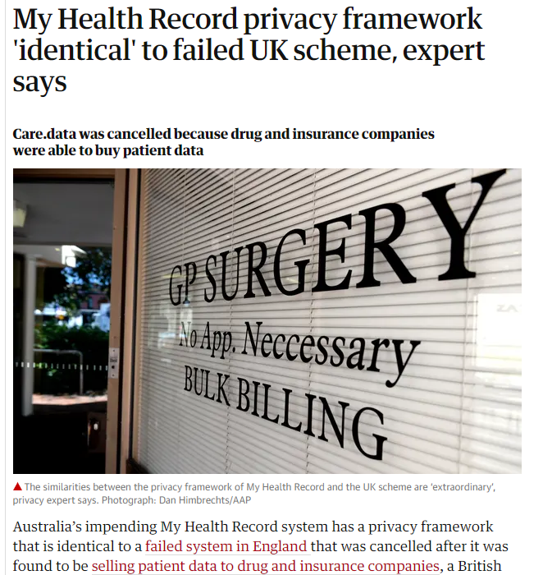
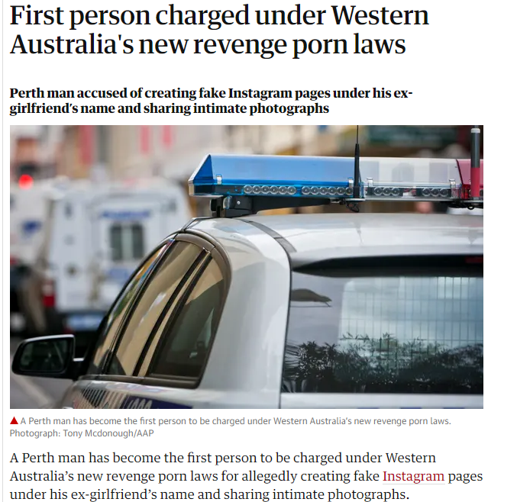
Sources

Slide 7
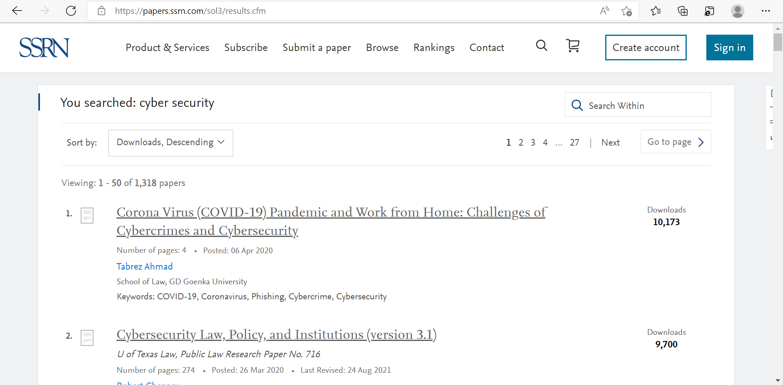
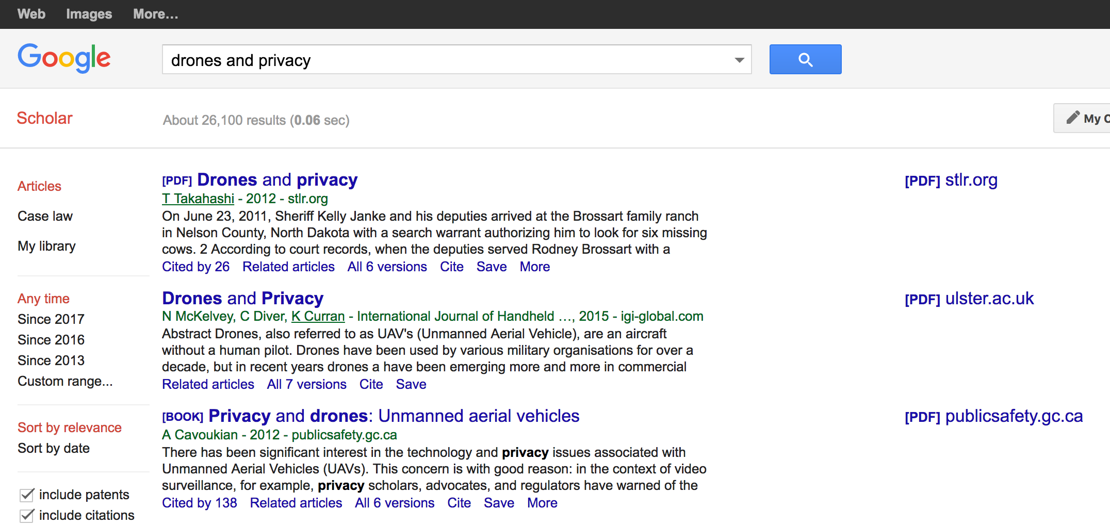
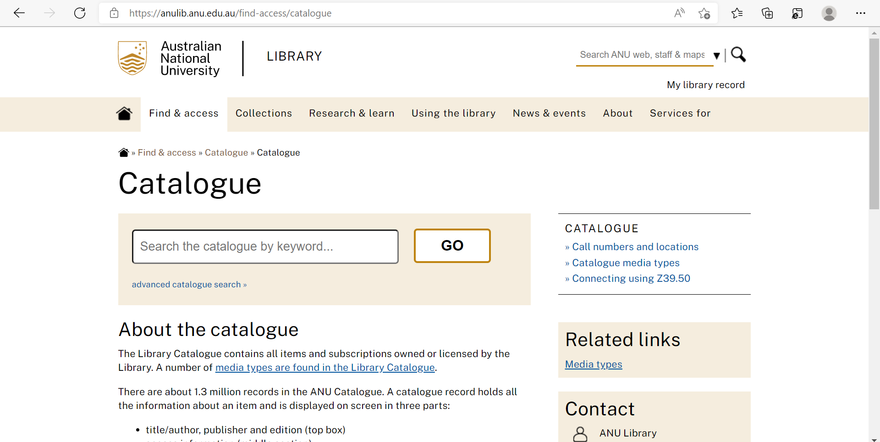
Sourcing the academic literature

Slide 8
Narrow down on a particular issue
Once you’ve found an issue or question of interest – READ EVERYTHING
What is the literature saying?
What are the live issues?
What are the fault lines?
Where are the active debates?
What is worth exploring further?
Remember that simply providing a survey / description of existing material is insufficient – you need an argument and you need to be analysing the material you encounter in order to develop your argument.
Start to break the question down conceptually and be strategic about your resources.

Slide 9
Focusing in
Develop a nose for relevance to focus on the texts that most relate to your questions / issues and approach / method.
Find an angle on your issue / question.
Understand the competing approaches from different authors.
What are their different backgrounds / politics / disciplines?
Drill down – follow bibliographies and citations.

Slide 10
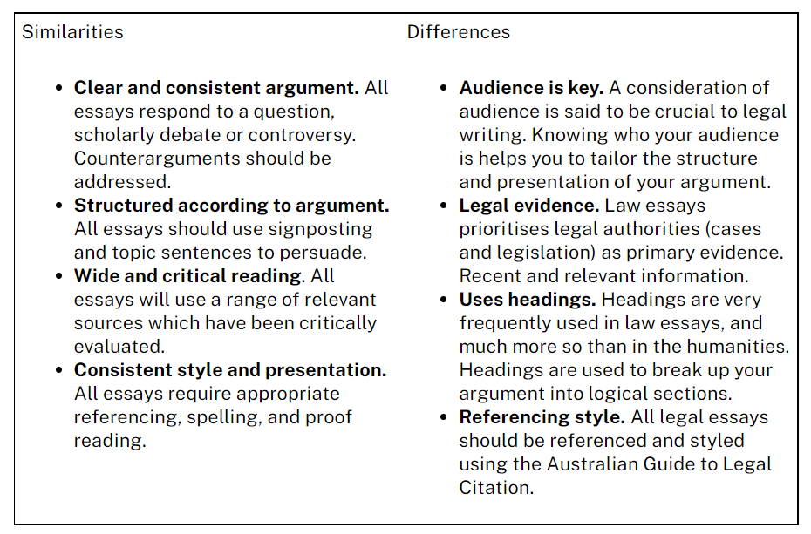
What makes a law essay a law essay?
Notes:
Taken from: Writing in Law - ANU

Slide 11
Assessment criteria
Understanding of the Issues
Addresses the research question and covers all the important points
Evidence of close consideration of the research question and the research materials drawn on
Issues raised by the topic are clearly and concisely identified
Material chosen relates clearly to the topic and is analysed not just summarised or quoted extensively.

Slide 12
Assessment criteria
Communication & Development of Argument
Clear theme or argument
Arguments logical and well-organised
Ideas/paragraphs linked coherently

Slide 13
Assessment criteria
Argument/Analysis
Originality of ideas and critical analysis of the material
Complexity and insight in dealing with theory/ideas
Suggestions for change where appropriate
Interdisciplinary perspective, where appropriate
Addressing opposing arguments
Well-reasoned conclusions

Slide 14
Assessment criteria
Research
Research covering primary and secondary materials
Good organisation of sources and ability to synthesise all the research materials used
Use of theoretical material where appropriate
Range of research sources (note: research must expand beyond class materials)
Integration of material from research resources into the essay

Slide 15
Assessment criteria
Presentation, style and referencing
Good use of structure, section headings and paragraphs
Clarity and conciseness of expression, interesting and engaging of reader
Use of appropriate terminology and correct grammar, syntax and spelling
Full and accurate footnotes together with a bibliography
Style according to Australian Guide to Legal Citation
Adherence to word limit

Slide 16


AGLC4-2021-v1.pdf (mulr.com.au)

